Slide 1
Fashion Boutique Sales Analysis
Capstone Project
Prepared by: Ebuka Nnadozie

Slide 2
Introduction
This project analyzes fashion boutique inventory data to identify trends in:
Product categories
Brands
Sizes
Colors
Customer ratings
Inventory value

Slide 3
Business Problem
Fashion retailers need to:
Manage inventory efficiently
Understand product distribution
Identify high-value categories
Improve decision-making

Slide 4
Dataset Overview
Dataset: Fashion Boutique Dataset
Attributes:
Brand
Category
Color
Size
Customer Rating
Inventory Value

Slide 5
Data Cleaning
Checked missing values
Removed duplicates
Verified data types
Prepared dataset for analysis

Slide 6
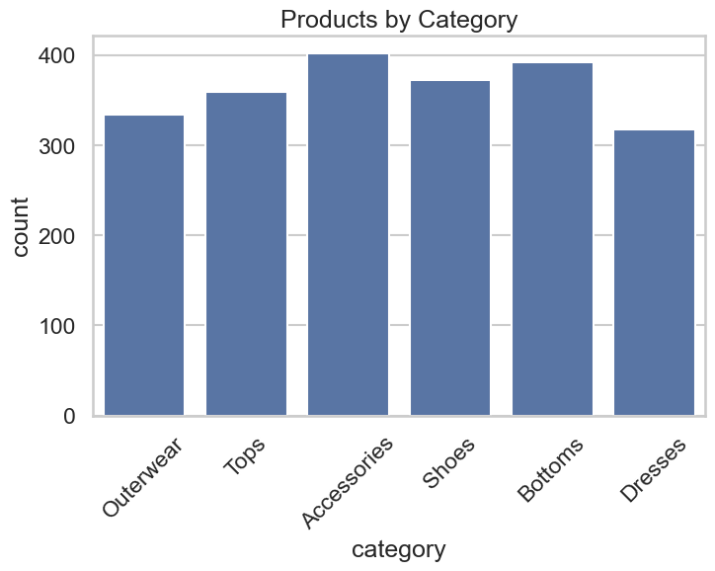
Products by Category
Text below chart:
Accessories contain the highest number of products, while Dresses contain the fewest. Product distribution varies significantly across categories.

Slide 7
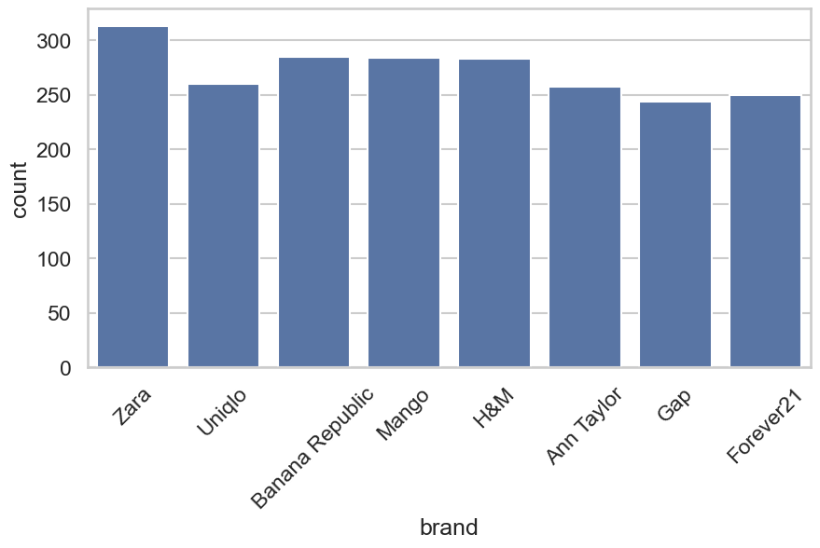
Brand Distribution
Zara has the highest number of products, followed closely by Banana Republic, Mango, and H&M.

Slide 8
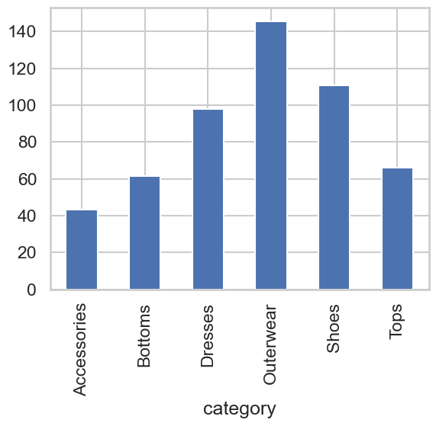
Category Performance Analysis
Outerwear demonstrates the strongest category performance, followed by Shoes and Dresses.

Slide 9
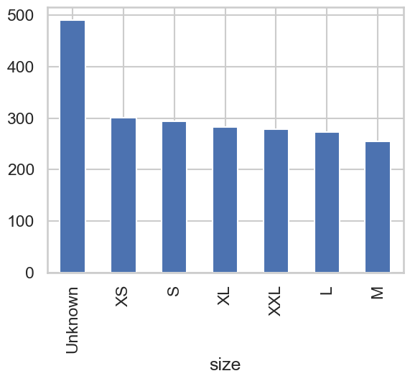
Product Size Distribution
Products with Unknown size represent the largest group. Improving size information would improve inventory quality

Slide 10
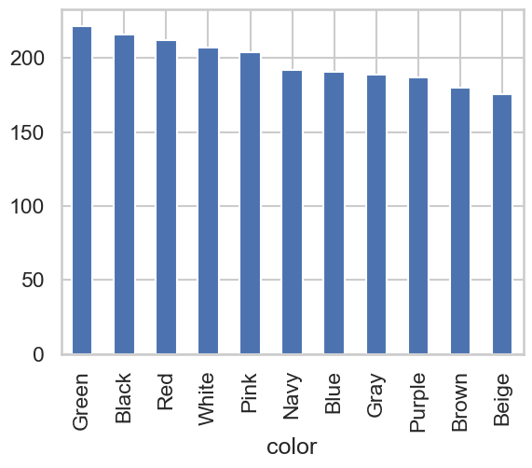
Product Color Distribution
Green, Black, and Red are the most represented colors in the inventory.

Slide 11
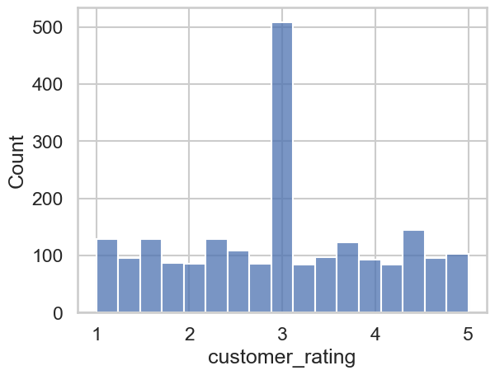
Customer Rating Distribution
Most customer ratings cluster around 3 out of 5, indicating moderate customer satisfaction

Slide 12
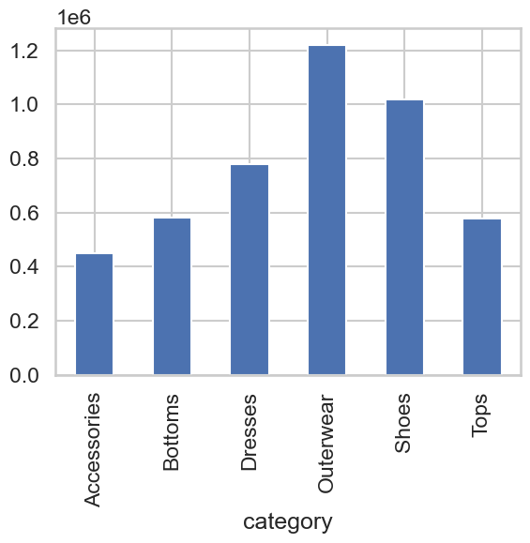
Inventory Value by Category
Outerwear generates the highest inventory value, followed by Shoes. Accessories have the largest product count but the lowest inventory value

Slide 13
Major Findings
Accessories have the highest number of products.
Zara has the most products among brands.
Outerwear has the highest inventory value.
Green is the most common color.
Unknown size appears most frequently.
Customer ratings center around 3.0.

Slide 14
Business Recommendations
Focus inventory investment on Outerwear and Shoes.
Improve product size data quality.
Monitor customer feedback to improve ratings.
Optimize stock allocation based on category value.
Continue tracking category trends for better planning.

Slide 15
Conclusion
The analysis identified important inventory and product trends that can help improve inventory management, product strategy, and profitability.

